Slide 1
Electricity Smart Metering Customer Behavior Trials (CBT) in Ireland
A pilot project review
January 21, 2015
Team Ragdolls
Janelle Becker
Kento Nakagawa
Brian Pest
Jenny Su
Yee Zhang

Slide 2
What is the electricity pilot?
Learning about testing and deployment of smart meters
Analyzing the effect of smart metering on energy consumption
Identifying risks and issues for nationwide rollout
Notes:
The CER initiated the Smart Metering Project in 2007 with the purpose of undertaking trials to assess the performance of Smart Meters, their impact on consumers’ energy consumption and the economic case for a wider national rollout.
It is a collaborative energy industry-wide project managed by the CER and actively involving energy industry participants.
The Smart Metering Electricity Customer Behaviour Trials (CBTs) took place during 2009 and 2010 with over 5,000 Irish homes and businesses participating. The purpose of the trials was to assess the impact on consumer’s electricity consumption in order to inform the cost-benefit analysis for a national rollout. Electric Ireland residential and business customers, and Bord Gáis Energy business customers, who participated in the trials had an electricity smart meter installed in their homes/premises and agreed to take part in research to help establish how smart metering can help shape energy usage behaviours across a variety of demographics, lifestyles and home sizes.

Slide 3
What data was collected?
Demographic information via surveys (pre- and post-trials)
Electricity consumption for every 30-minute interval recorded via smart meter
Data relayed through various telecommunication channels
Baseline data collected in 2009, treatment collected in 2010
Notes:
Pre-trial survey of participants in the Trial. Information gained from this survey provided insights which informed the participant allocation and provided a benchmark for any subsequent change in behaviour which might be measured at the end of the Trial.
Post-trial survey of the same participants in January 2011, comparing change in attitude, equipment or electricity use to the pre-trial findings.

Slide 4
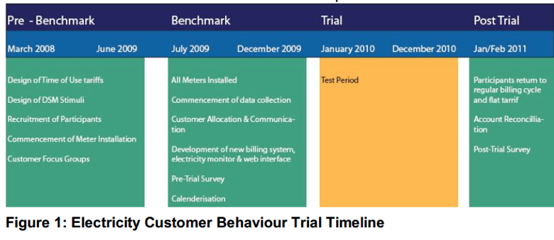
How was it implemented?
Notes:
Two major periods: benchmark period(July-Dec 09) and test period(Jan-Dec 2010).
Recruitment of Participants:
All participants recruited via an invitation letter to voluntary “opt-in” by sending in a tear off slip. The average response rate was about 30% with 5375 participants initially recruited and 5028 still on the Trial in Nov 2009. Participants were profiled to confirm that the sample was nationally representative on demographic statistics. Each participant paid 25 EURO for the pre- and post-trial survey towards their bill in December 2009 and January 2011.
Participants randomly assigned to either a control or a treatment group with ToU pricing.

Slide 5
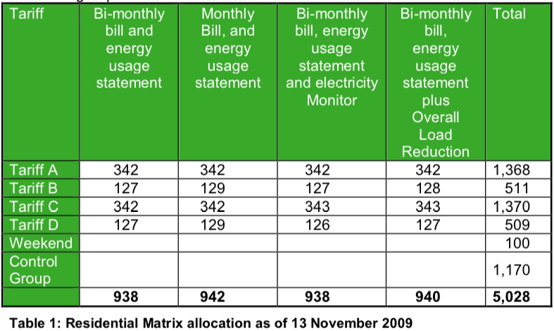
Group Distribution
Notes:
For treatment group:
Four tariff options(A, B, C, D) offering different unit prices during a day.( Day, Peak, Night)
DSM initiatives:
bi-monthly electricity bill with detailed energy statement
monthly electricity bill with detailed energy statement
electricity monitor
an Overall Load Reduction (OLR) incentive [ 20 EUR reward if they reduced overall consumption (relative to baseline) by 10% of an 8-month period.]
web access to energy usage information

Slide 6
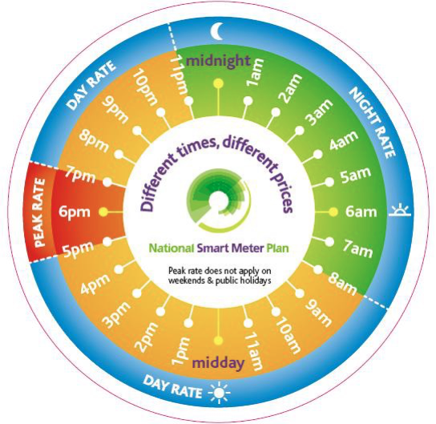
Time of Use (TOU) Pricing

Slide 7
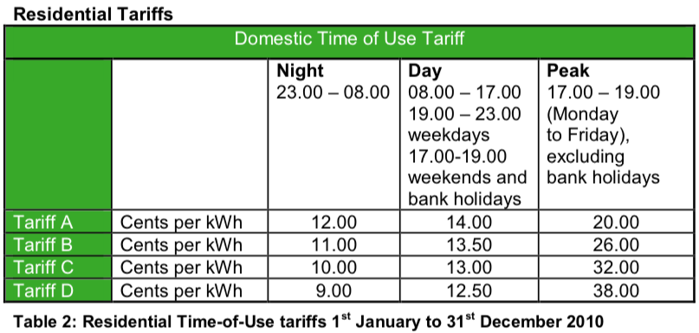
Residential Tariffs
Notes:
Four tariff options(A, B, C, D) offering different unit prices during a day.( Day, Peak, Night)
Balancing Credit:
Participants guaranteed they would not pay more compare to the normal Electric Ireland tariff ( 14.1/unit).
The small number of of customers paying “out of pocket” will be compensated on a case by case basis after the Trial is completed.

Slide 8
Survey Objectives
Demographic and lifestyle profiling
Motivation of the participants
Reported behavior related to energy
Engagement with the topic of energy
reduction and behavior change
Notes:
To determine who opted to participate in the trial
To determine why they joined
To determine who likely they are to behave during the trial
To determine how likely they are to stay for the entire period and become engaged in the objectives of the trial

Slide 9
Surveys
Pre-trial survey
Post-trial survey
Includes awareness and responses to trial/treatment
Non-response survey
Notes:
Survey questions included Sex, age, employment, income, internet access, number of residents, interest and experience in reducing electricity use, feelings toward environment, information on appliances & energy use.

Slide 10
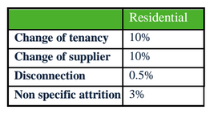
Implementation Issues and Analysis Challenges
Attrition
Telecommunications issues
Impact of balancing credit on incentive scheme
Notes:
Some telecommunications issues arose that obstructed real-time communication smart meters, although most of the data could be collected given enough time (retrospectively). Though some telecom technologies performed better than others.

Slide 11
Results of CER Study: Main Takeaways
Overall: 2.5% usage reduction
Peak periods: 8.8% reduction
Load shifting from peak periods to night time
82% of residents made changes in usage
Potential to provide net benefit up to $200M over next 15 to 20 years

Slide 12
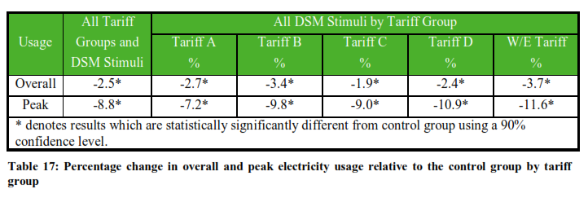
Percent Changes vs. Control Group
Based on Tariff and DSM Stimuli

Slide 13
What was most effective?
Tariffs
No single tariff strictly dominated
No evidence of “tipping point”
DSM
Bi-monthly bill, energy statement, and electricity usage monitor
Overall: 3.2% reduction
Peak period: 11.3% reduction
Notes:
For overall reduction:
Tariff B more effective than Tariff C
For peak period reduction
A not as effective as all the rest
tipping point is defined as the two price profiles between which the price premium causes
a significant reduction in usage.

Slide 14
Combinations for Biggest Reductions
Peak usage: 13.9% reduction
(D3) Tariff D + bi-monthly, usage statement, and in-home electricity monitor
Overall usage: 4.3% reduction
(B4) Tariff B + OLR Incentive

Slide 15
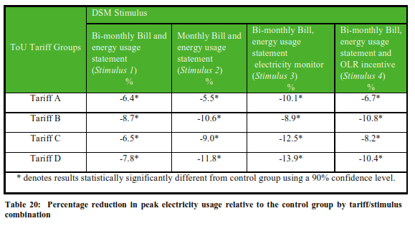
Peak Period

Slide 16
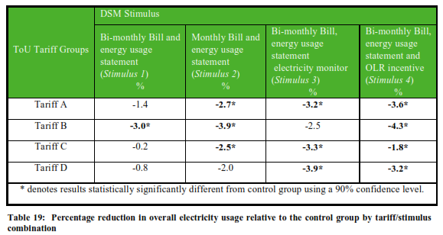
Overall
Notes:
Overall Load Reduction incentive
o OLR: 20 EUR reward if they reduced overall consumption (relative to baseline) by 10% of an 8-month period.

Slide 17
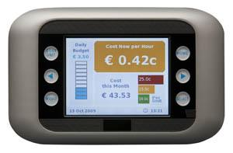
Fin
Questions?

